Slide 1





Database Architecture Project (Netflix Data Analysis)
1 . Karan Parmar
2. Shrajna Shetty
3. Aman Khan

Slide 2
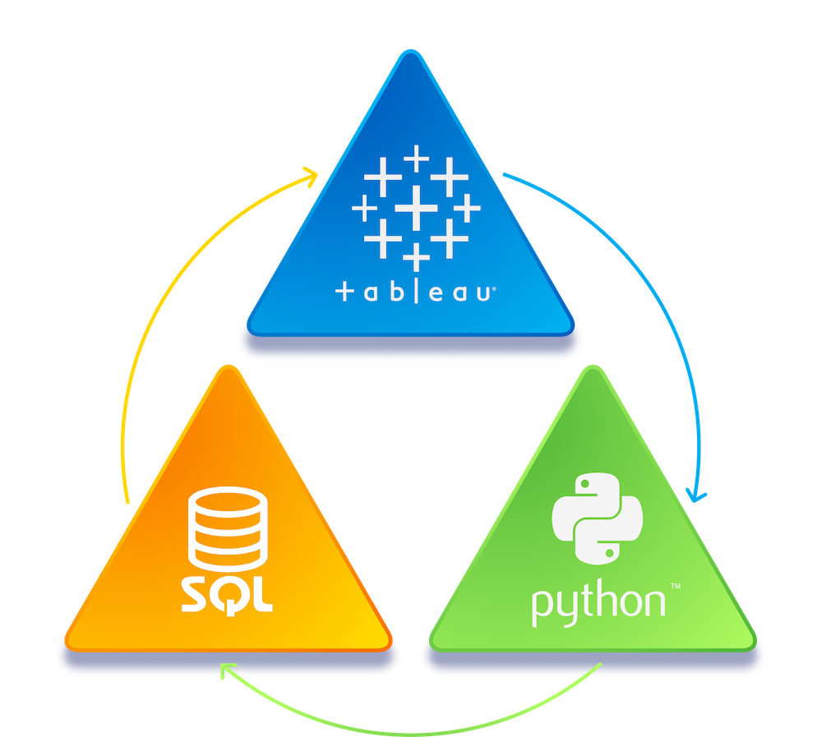
Project Objectives
Data ETL: Extract, clean, and transform the netflix dataset using python and load it into oracle SQL for further analysis.
Data Storage: Organize the data into structured tables in Oracle SQL developer for easy management and querying.
Data Mining: Perform SQL and pl-sql based queries to uncover key insights like popular genres, top content of each genre, and release trends.
Data Visualization: Create interactive and insightful dashboards in Tableau to visualize the data and present findings.

Slide 3
Project Plan
Step 1: Data ETL (Extract, Transform, Load)
We will utilize Python and the Pandas library to clean and transform the Netflix dataset. This step includes handling missing data, formatting columns (like converting release years to proper formats), and standardizing the dataset for analysis.
Tool Used: Python (Pandas)
Process:
Load dataset into a Pandas DataFrame.
Clean and transform the data, removing null values and converting columns to the proper data types.
Save the cleaned data as a CSV file for importing into Oracle SQL.
Sample Code:
import pandas as pd df = pd.read_csv('netflix_data.csv') df.dropna(inplace=True) df['release_year'] = df['release_year'].astype(int) df.to_csv('cleaned_netflix_data.csv', index=False)
Outcome: A cleaned CSV file, ready for import into Oracle SQL Developer.

Slide 4
Data Storage
Step 2: Once the data is cleaned, we will load it into Oracle SQL Developer 21c using the built-in CSV import feature. A table will be created to store the dataset, allowing us to efficiently manage and query the data for analysis.
Tool Used: Oracle SQL Developer 21c
Process:
Create a table in Oracle SQL for storing the Netflix data.
Use the CSV import function to load the cleaned dataset into the newly created table.
Outcome: The cleaned dataset will be stored in a structured table format within Oracle
SQL Developer will be used for further analysis.

Slide 5
Data Mining
Step 3: We will analyse data using SQL queries in Oracle SQL Developer to extract insights such as popular genres, most watched in each genre, and content release trends.
Tool Used: Oracle SQL Developer 21c
Process:
A. Write and execute SQL and PL/SQL queries to explore patterns in the data. B. Focus on identifying key trends, such as the most popular genres, top-performing countries, and content release history over time.
Example Queries:
A. Top 5 popular genres:
SELECT genre, COUNT(*) AS count FROM netflix_data GROUP BY genre ORDER BY count DESC FETCH FIRST 5 ROWS ONLY;
B.Country-wise content distribution:
SELECT country, COUNT(*) AS content_count FROM netflix_data GROUP BY country ORDER BY content_count DESC;
Outcome: Detailed insights into the dataset based on SQL analysis.

Slide 6
Data Visualization
Step 4: Finally, we will present our findings using Power BI or Tableau by creating interactive dashboards and visualizations. These tools will help visualize patterns and trends in the dataset.
Tools: Tableau
Process:
A. Connect Tableau to the Oracle database. B. Build visualizations such as bar charts for genre popularity, maps for content by country, and line graphs for content release trends
Outcome: A visually appealing dashboard to present the results of our analysis to stakeholders, providing insights at a glance.

Slide 7
Dataset Exploration
1. Content Type Distribution
Movies dominate the catalogue, showcasing Netflix’s focus on feature films.
TV Shows make up a smaller portion, but Netflix has increased its production of series in recent years.
2. Geographical Presence
Top Countries: Most content comes from the United States, Mexico, Brazil, and Singapore, reflecting Netflix's focus on North American and Latin American markets with growing expansion in Asia.
International Variety: Netflix is expanding its global footprint by including a diverse range of international content.
3. Content by Year of Release
Recent Additions: The majority of content is from 2015 onwards, aligning with Netflix’s rise in original productions.
Older Content: Titles from pre-2010 are present, adding nostalgic and classic options to the catalogue.

Slide 8
Dataset Exploration
4. Popular Actors & Directors
Frequent appearances by actors like João Miguel and Demián Bichir, showing Netflix's regional focus, especially in Latin America.
A diverse cast reflects Netflix’s approach to global appeal.
5. Ratings and Audience Target
Predominance of TV-MA (Mature Audience) content suggests a focus on adult viewers.
Other ratings like PG-13 cater to a wider audience.
6. Genres
Popular genres include:
- International TV Shows & Dramas
- Sci-Fi & Fantasy
- Action & Adventure
- Independent Movies
These genres reflect Netflix's commitment to varied content for both mainstream and niche audiences.

Slide 9
Data Cleaning Using Pandas
Key Steps:
1.Handling Missing Values
2.Removing Duplicates
3.Converting Data Types
4.String Handling
5.Filtering Data for Analysis

Slide 10
1. Handling Missing Values
Functions:
fillna(): Replace missing values with defaults
dropna(): Remove rows with missing values
Example:
df['director'].fillna('Unknown', inplace=True) df['cast'].fillna ('Unknown', inplace=True) df.dropna(subset = ['title’, 'release_year'], inplace=True)

Slide 11
2. Removing Duplicates
Functions:
drop_duplicates() : Removes redundant rows based on unique identifiers .
Example:
df.drop_duplicates(subset=['show_id'], inplace=True)

Slide 12
3. Data Type Conversion
Convert columns to appropriate types for analysis:
release_year: Integer
date_added: Datetime
Example: df['release_year'] = df['release_year'].astype(int) df['date_added'] = pd.to_datetime(df['date_added'], format='%d- %b-%y')

Slide 13
4. String Handling
Functions: str.strip(): Remove leading/trailing spaces str.replace(): Replace incorrect characters
Example: df['title'] = df['title'].str.strip() df['title'] = df['title'].str.replace('Ã¶', 'ö')

Slide 14
5. Filtering Data
Functions: loc [ ] : Filter rows by conditions query( ): Query for specific subsets
Example:
movies_after_2010 = df.loc[(df['content_type'] == 'Movie') &
(df['release_year'] > 2010)]

Slide 15
Dashboard Creation
Create an interactive dashboard that combines various visualizations into one cohesive view.
Steps to Create a User-Friendly Dashboard:
1. Bar Chart (Movies vs. TV Shows): Count the number of movies vs. TV shows in the dataset.
2. Stacked Bar Chart (Titles by Genre): A stacked bar chart showing the number of titles categorized by genre.
3. Map Visualization (Titles by Country): A map showing the number of titles by the country where they were produced.
4. Line Chart (Titles Released per Year): A line chart tracking how many titles were released each year.

Slide 16
Future Perspective
Advanced Data Analysis using Machine Learning (ML):
Current Approach: SQL queries for data mining and insight generation. Upgrade Suggestion: Enhance data mining by incorporating machine learning models. For instance, use Python's Scikit-learn or TensorFlow to predict content trends (e.g., next trending genre or popular country), or apply natural language processing (NLP) to analyze movie descriptions for sentiment analysis.
Why?
Predictive analytics adds value by generating more sophisticated insights into future content trends and viewer preferences.
Future Tools: Scikit-learn, TensorFlow, NLP libraries (spaCy, NLTK).

Slide 17
Future Perspective
Real-Time Data Analysis:
Current Approach: Batch processing and analysis of static datasets. Upgrade Suggestion: Incorporate real-time streaming data into your architecture using platforms like AWS Kinesis. This will allow real-time insights and updates as new content or data gets added to Netflix.
Why?
Real-time data allows for quicker decision-making, especially when working with live datasets (e.g., Netflix's latest content additions or viewership data).
Future Tools: AWS Kinesis.

Slide 18
THANK YOU
Thank you for listening!
We are open to any questions and we highly appreciate any feedback or suggestions!

